Slide 1


Slide 2

Notes:
What's the last great TV show or movie you watched?
https://www.polleverywhere.com/free_text_polls/1bWcItYY3Lz5IwIaJ7JVA

Slide 3

Day 2: Visualization, Dimensionality Reduction and Manifold Learning
Notes:
TA introduction
Talk about not teaching code (not a programming workshop)

Slide 4
Thinking about high dimensional data
Notes:
TA introduction
Talk about not teaching code (not a programming workshop)

Slide 5
Our Data is a High-dimensional Matrix
variables
observations
gene1
gene2
gene3
Cell1
d11
d12
Cell2
d21
d22

Slide 6
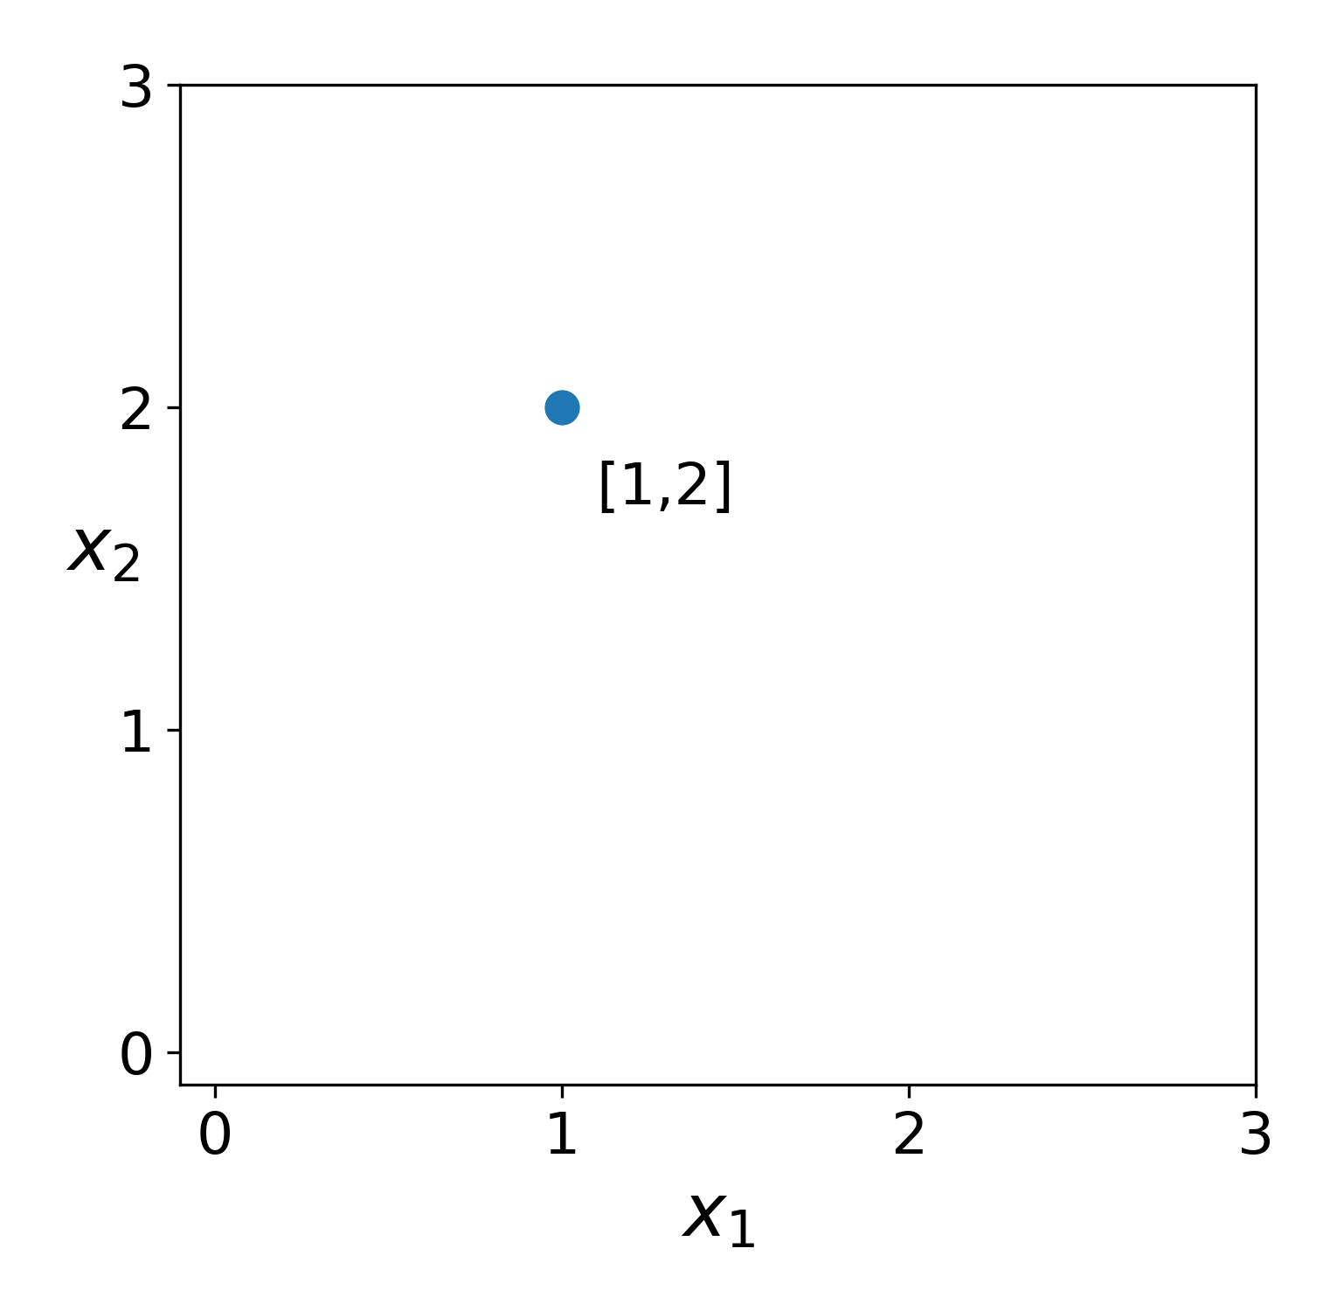
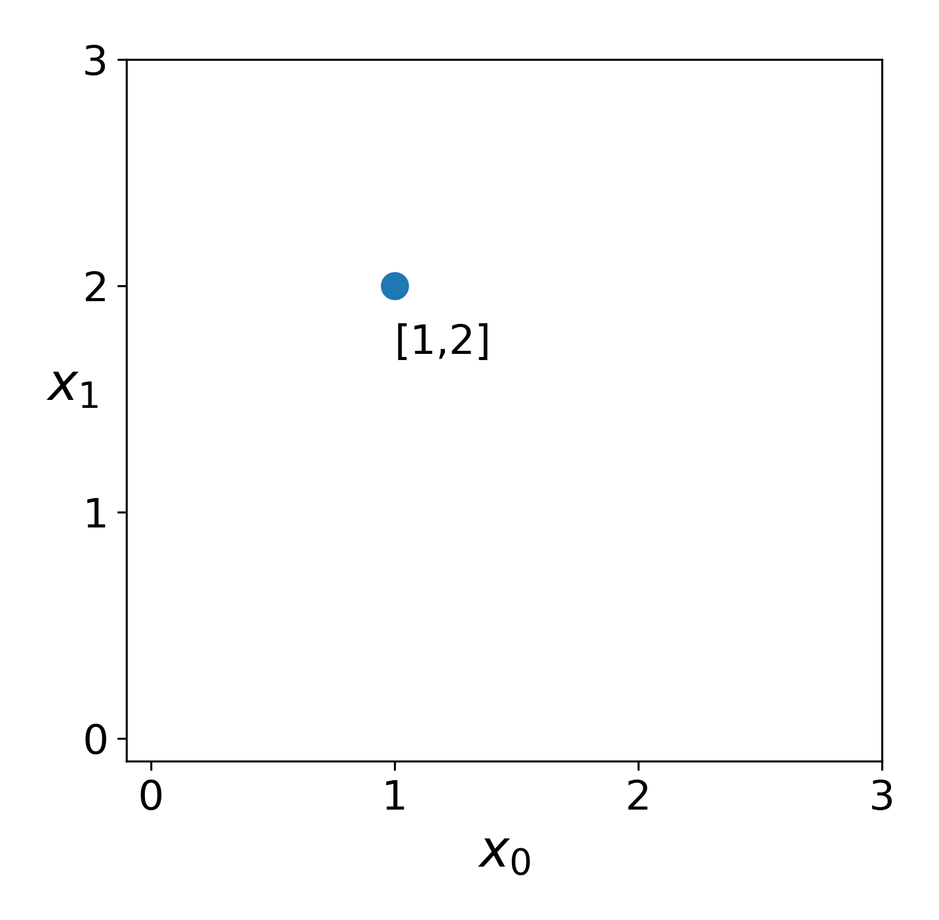

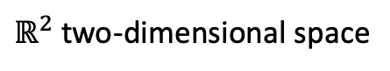
What does “dimensionality” mean?
$ℝ^{2}$ two-dimensional space
$$a$$

Slide 7
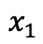
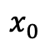
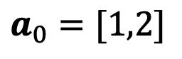
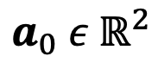
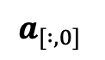
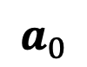
Features are dimensions
vector
coordinate space
$ℝ^{2}$ two-dimensional space
$$a_{0} ε{ ℝ}^{2}$$
$$a_{0}=[1,2]$$
$$a_{0}$$
$$x_{0}$$
$$x_{1}$$
features
$$a_{[ :,0]}$$

Slide 8
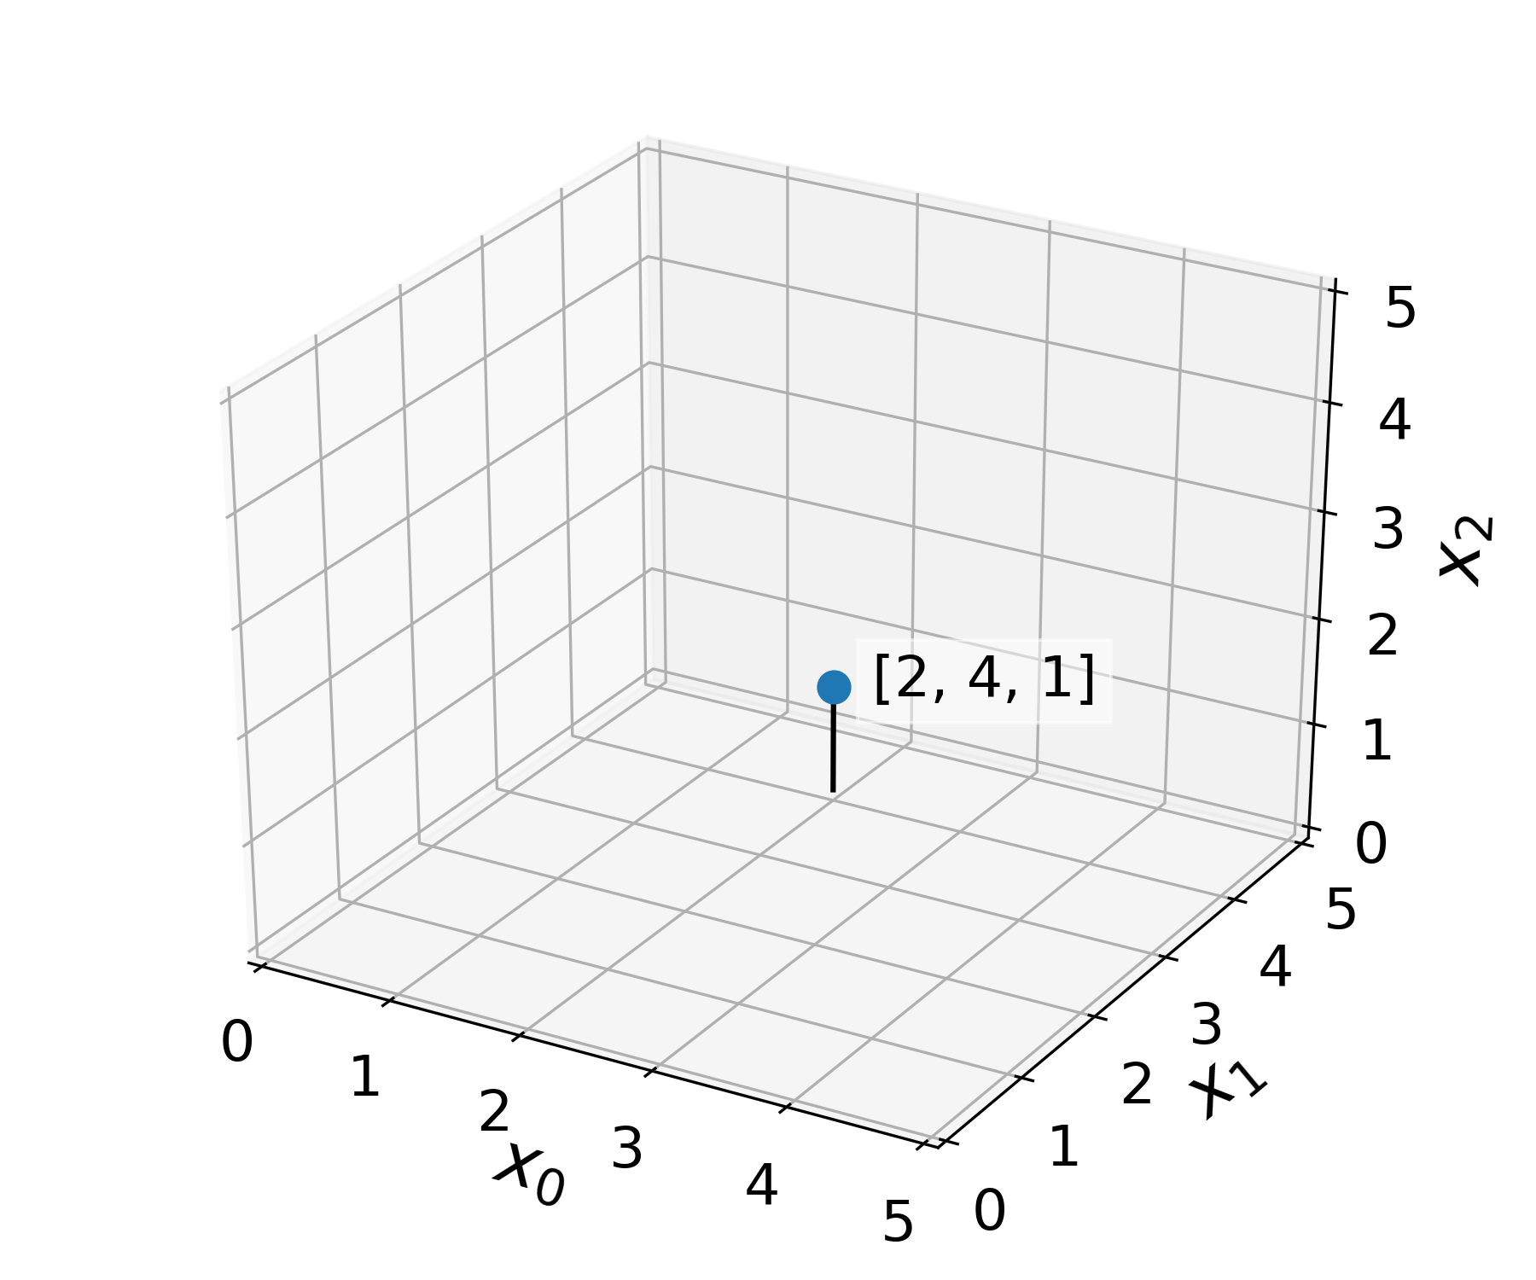
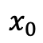
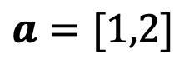
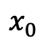
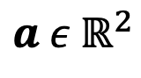
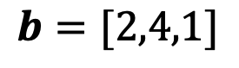

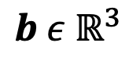
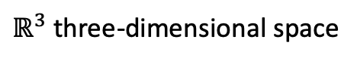
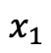
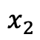
Features are dimensions
$$a ε{ ℝ}^{2}$$
$ℝ^{3}$ three-dimensional space
$$a=[1,2]$$
$$x_{0}$$
$$x_{1}$$
$$b ε{ ℝ}^{3}$$
$$b=[2,4,1]$$
$$b$$
$$x_{0}$$
$$x_{1}$$
$$x_{2}$$

Slide 9
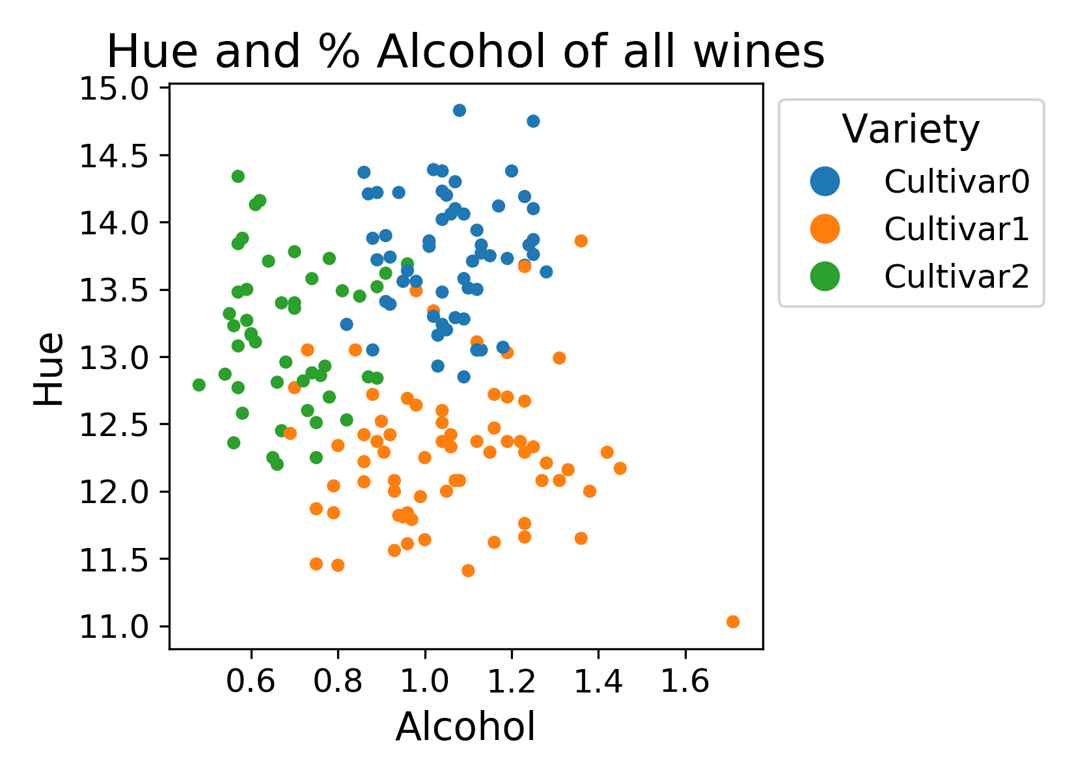
Features reveal structure
Feature 2
Feature 1

Slide 10
Many types of structure can exist in data
Feature 2
Feature 1

Slide 11
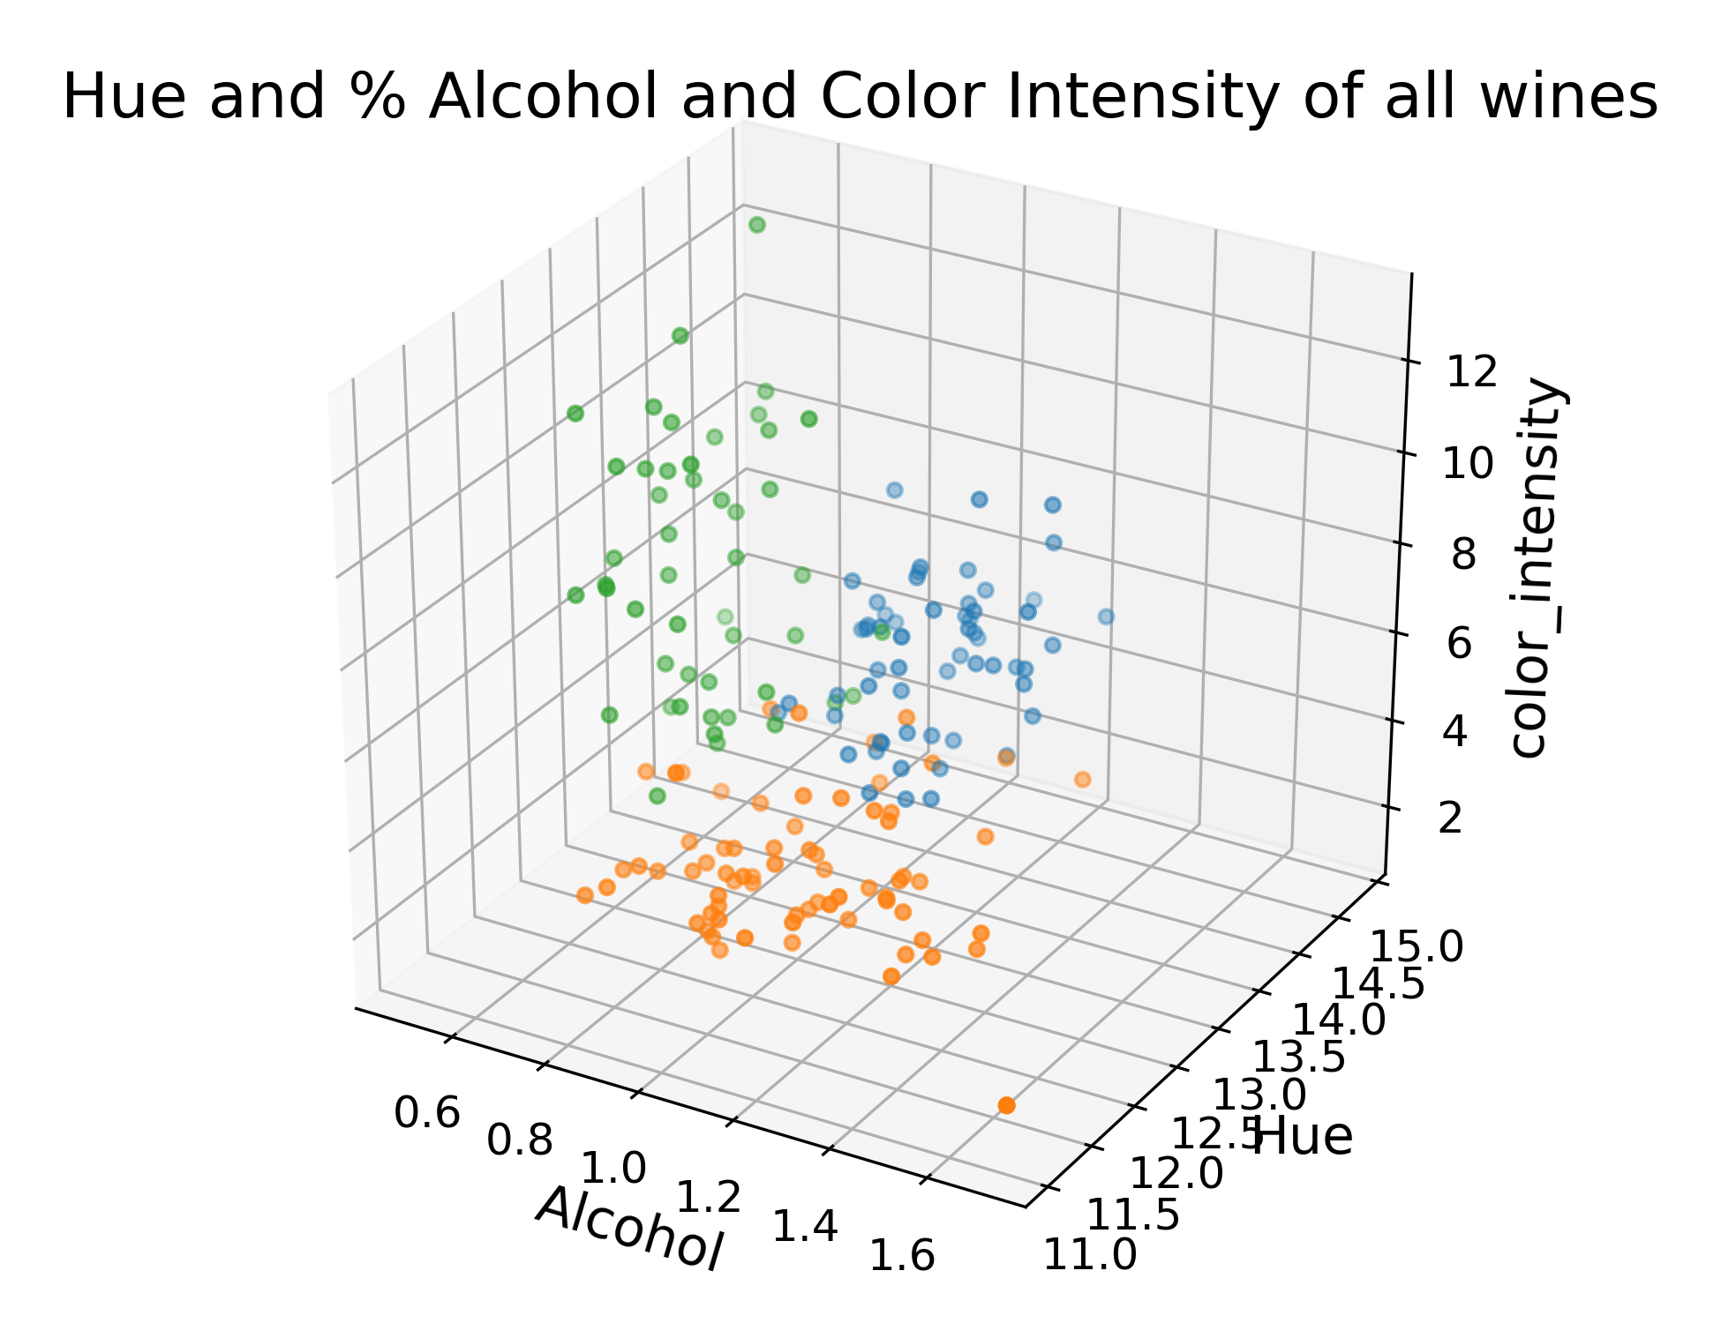
More Dimensions = More Accurate Structure

Slide 12
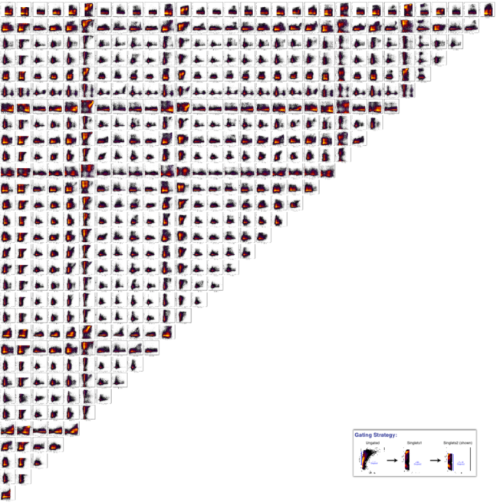
Problem: We can only see in 3D (not 20K D)
We could try all 2D pairs,
but our brains can’t put this
together
Notes:
Are the green and orange cultivars really different? How could we tell?

Slide 13
Solution: Dimensionality Reduction

Slide 14
Thought Exercise: Reduce this to 1D
Feature 2
Feature 1
Notes:
Are the green and orange cultivars really different? How could we tell?

Slide 15
Thought Exercise: Reduce this to 1D
Most distant points on top of each other !
Feature 2
Feature 1
Notes:
Are the green and orange cultivars really different? How could we tell?

Slide 16
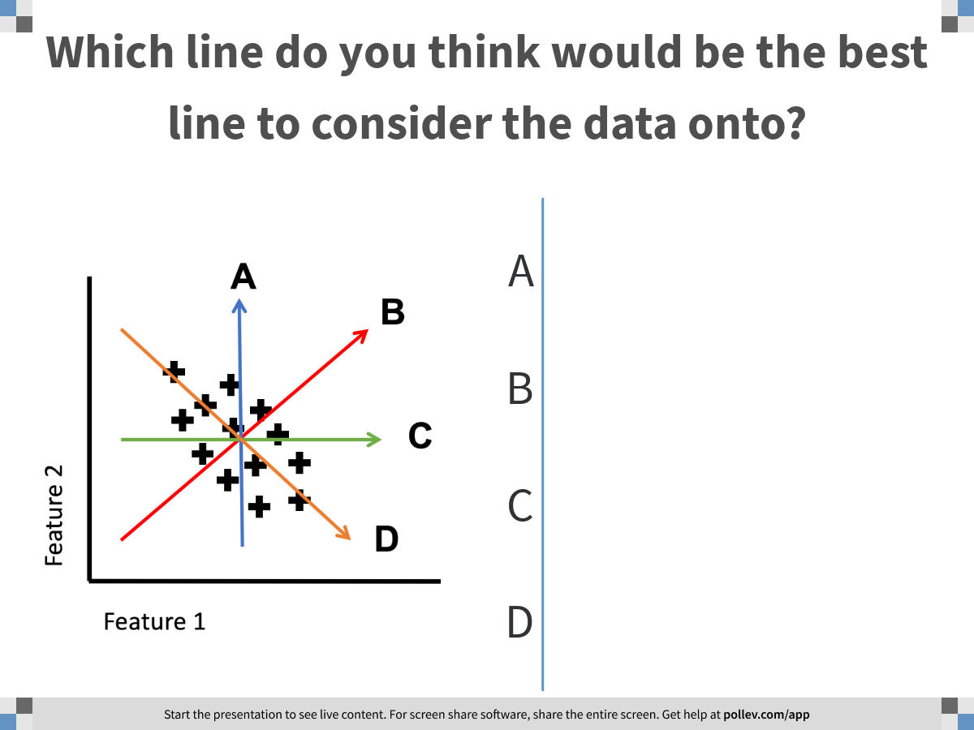
Notes:
Which line do you think would be the best line to consider the data onto?
https://www.polleverywhere.com/multiple_choice_polls/HAQR84GN9TY1YBStZDwh1

Slide 17
Thought Exercise: Reduce this to 1D
Feature 2
Feature 1
Notes:
Are the green and orange cultivars really different? How could we tell?

Slide 18
Thought Exercise: Reduce this to 1D
What is special about
this line?
It explains most of the variance in the data
Feature 2
Feature 1
Notes:
Are the green and orange cultivars really different? How could we tell?

Slide 19
Principle Components Analysis
PCA linear directions
in the data that explain
the most variance
PC1 explains the most
PC2 explains the next most
and is orthogonal to PC1
PC1
PC2
Feature 2
Feature 1
How do we find these directions?
Notes:
Are the green and orange cultivars really different? How could we tell?

Slide 20
Covariance Matrix

Slide 21
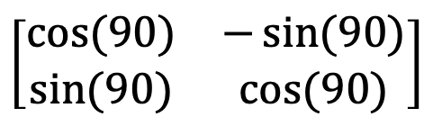
Matrices as Transformations
Matrices only store data, but can also represent transformations
Specifically they are linear transformations
They transform lines by changing their length and angle from origin
$$\left[\begin{matrix}cos⁡(90) & −\sin{(90)} \\ sin⁡(90) & cos⁡(90)\end{matrix}\right]$$
*
=
Rotation matrix
Line
Rotated
Line

Slide 22
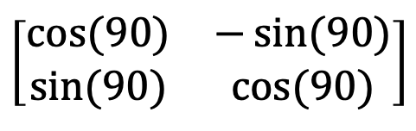
Matrix–Vector Notation
Lines can be described as vectors from the origin
(1,1)
1
Line
1
$$\left[\begin{matrix}cos⁡(90) & −\sin{(90)} \\ sin⁡(90) & cos⁡(90)\end{matrix}\right]$$
1
-1
=
1
1

Slide 23
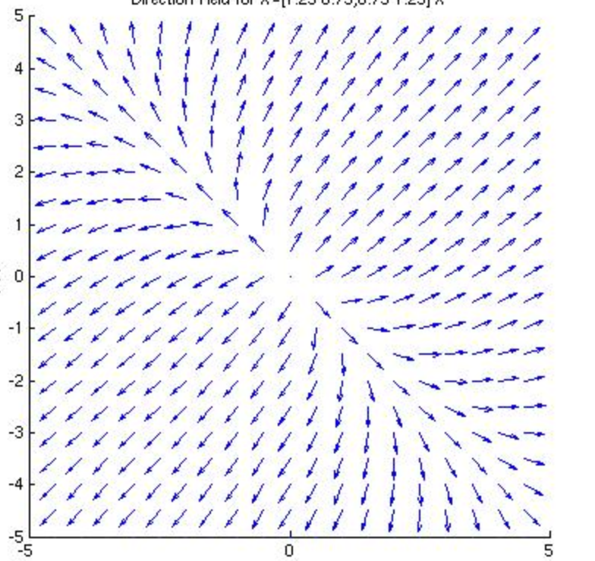
Eigenvectors
Rotation matrices rotate lines
in only one direction
Other matrices can move different lines in different directions
Such linear transformations have fixed points called Eigenvectors
In other words, the transformation only stretches the vector and does not rotate it.

Slide 24
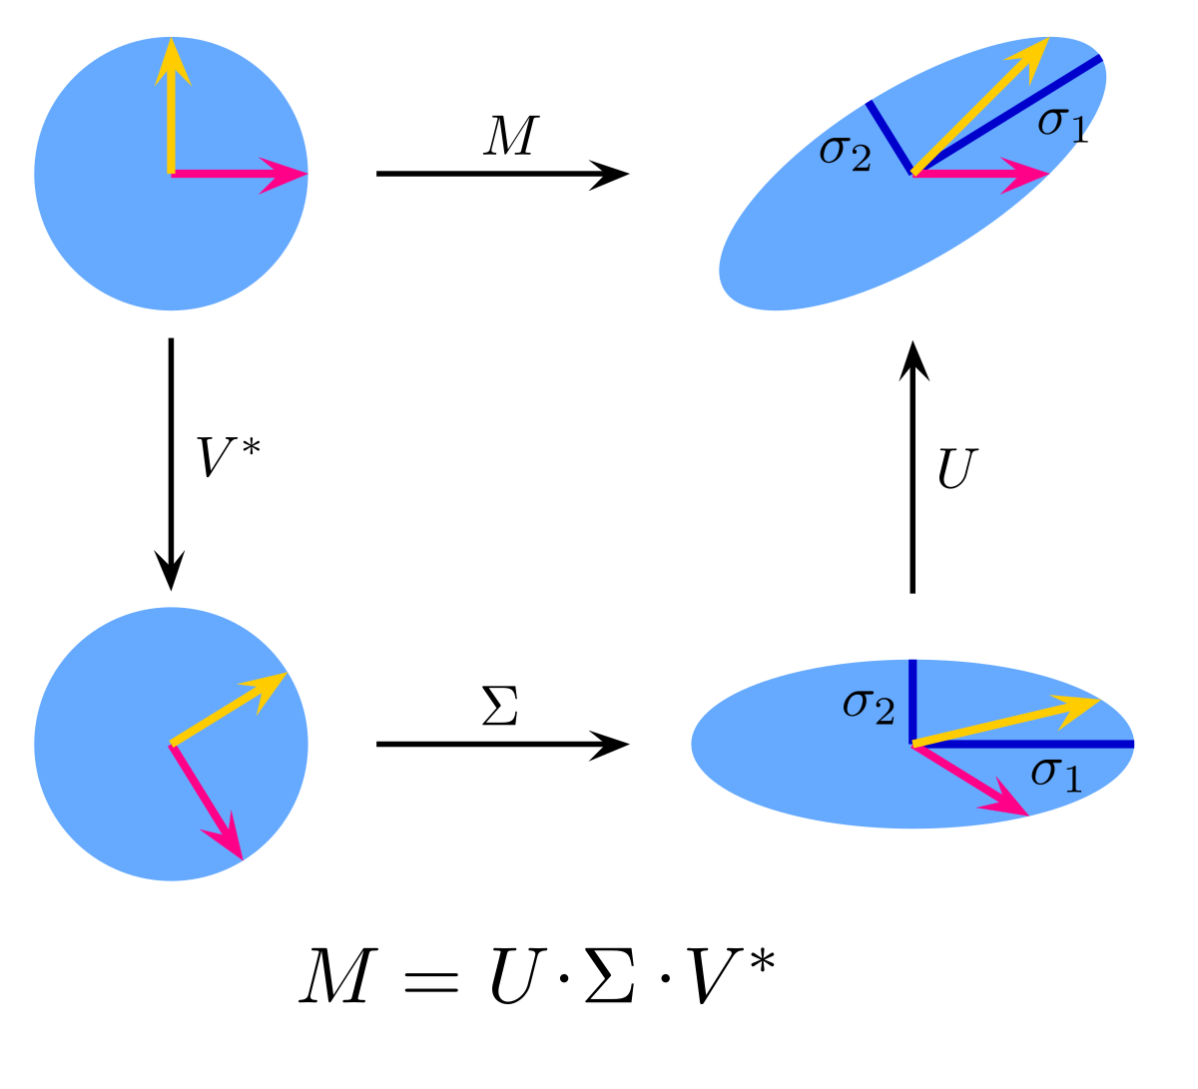
Eigendecomposition
Eigenvectors can be used to decompose a linear transformation into a rotation + stretch + anti-rotation
Non-square matrices
have similar OP called
Singular value decomposition

Slide 25
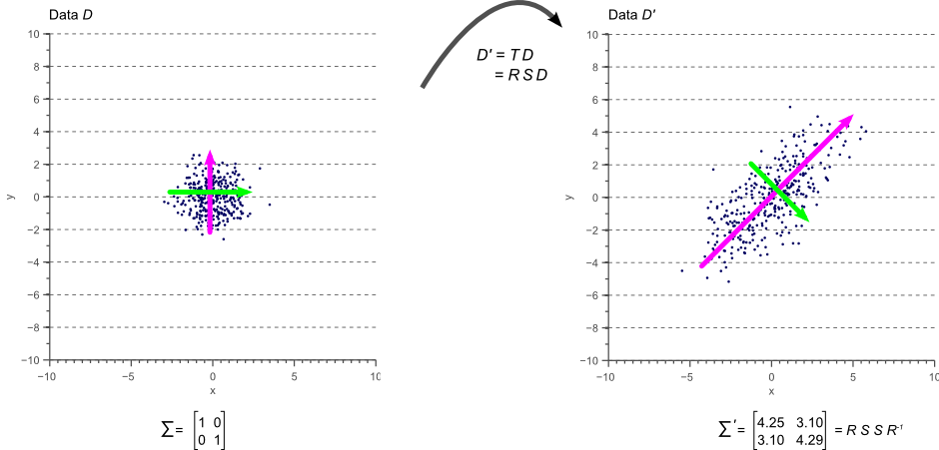
Eigenvectors of Covariance
Matrix creates correlation structure of data on unit blob

Slide 26
Principle Components Analysis
PC1 is first eigenvector (with
Highest eigenvalue)
PC2 is next eigenvector
PC1
PC2
Feature 2
Feature 1
Notes:
Are the green and orange cultivars really different? How could we tell?

Slide 27
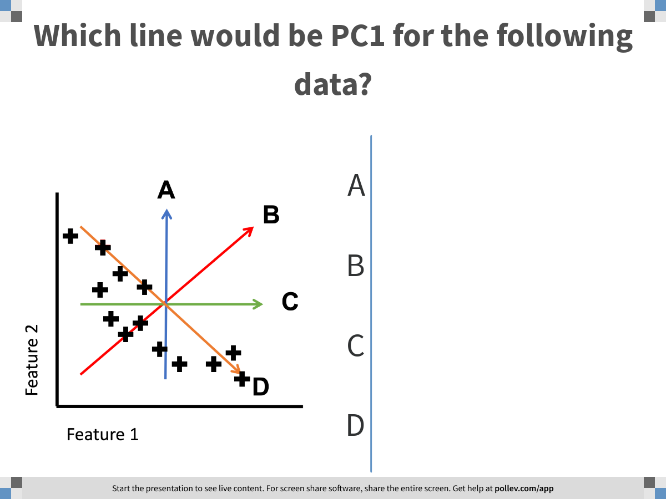
Notes:
Which line would be PC1 for the following data?
https://www.polleverywhere.com/multiple_choice_polls/XqXZHtwAyYj9nIw41hdOt

Slide 28
Quick quiz
Which line would be PC1 for the following data?
A
B
C
Feature 2
D
Feature 1

Slide 29
Non-linear structure
What if the data looked like this?
What line would be good
to project to here?
Feature 2
Feature 1
Notes:
Are the green and orange cultivars really different? How could we tell?

Slide 30
Non-linear dimensionality reduction
Notes:
TA introduction
Talk about not teaching code (not a programming workshop)

Slide 31
Non-linear dimensions
To find non-linear or “coiled” dimensions in a dataset we have to understand, and describe the shape of the data
The data can live in lower dimensions
This can be abstractly called the data “manifold”
Feature 2
Feature 1
Notes:
Mention that the “manifold dimensionality” of this manifold is 2d

Slide 32
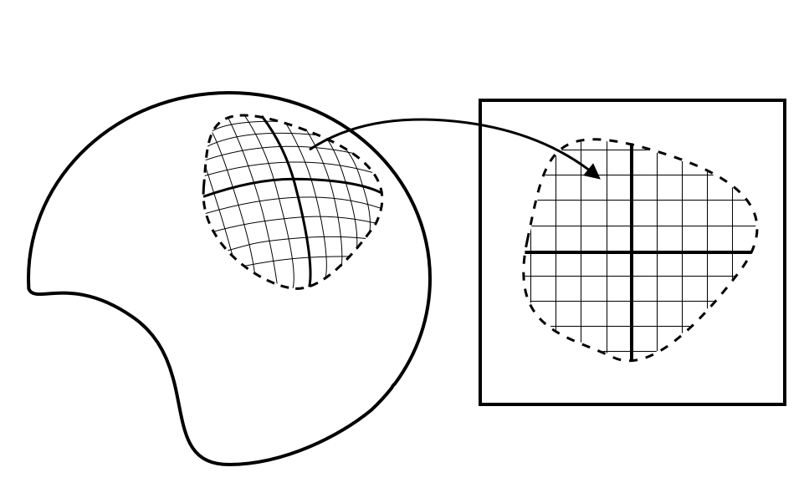
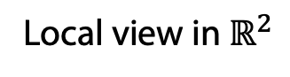
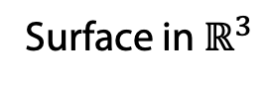
What is a manifold?
Surface in $ℝ^{3}$
Local view in $ℝ^{2}$
Locally smooth
Locally Euclidean
Generally, lower dimensional than the ambient space (i.e. a subspace)
Notes:
Mention that the “manifold dimensionality” of this manifold is 2d

Slide 33
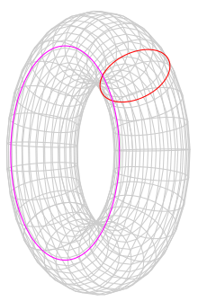
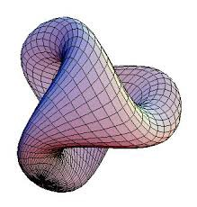
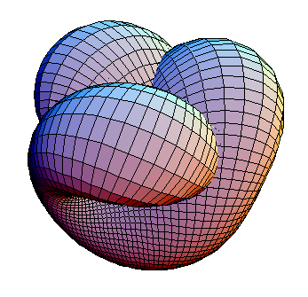
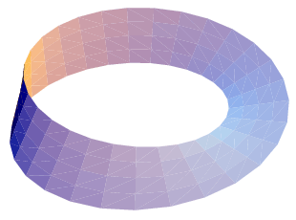
Examples of manifolds
Wolfram
Notes:
Mention that the “manifold dimensionality” of this manifold is 2d

Slide 34
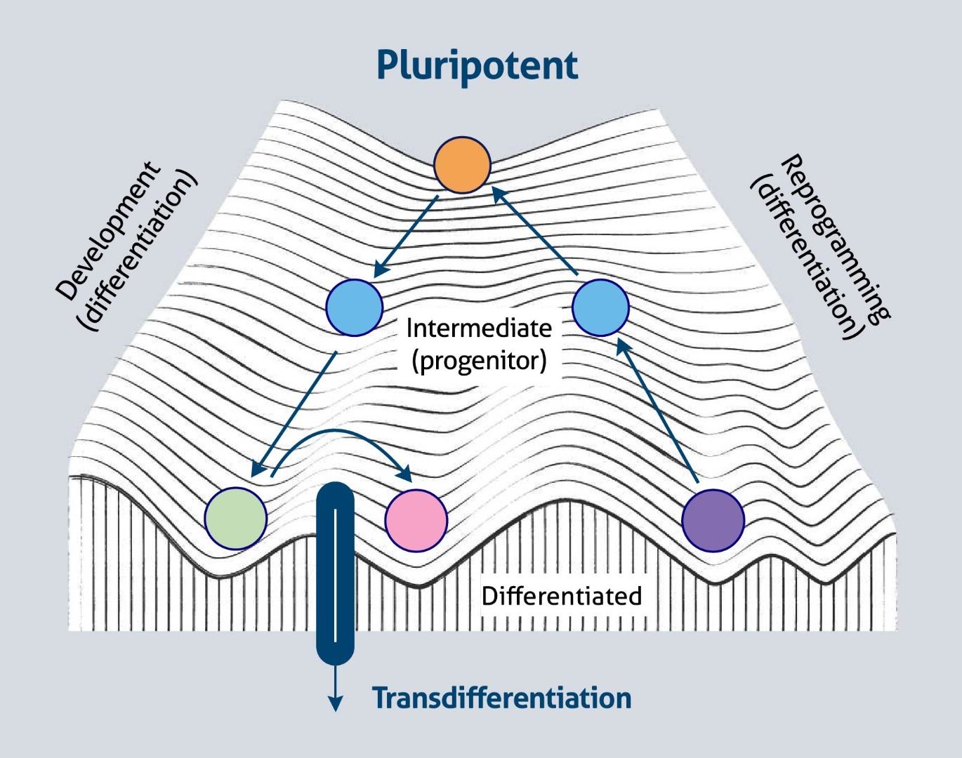
Examples of manifolds
Waddington’s landscape
Wolfram
ptglab.com
Notes:
Mention that the “manifold dimensionality” of this manifold is 2d

Slide 35
Examples of manifolds
Waddington’s landscape
Smooth transitions between states
Small changes in gene expression are linear
Wolfram
ptglab.com
Notes:
Mention that the “manifold dimensionality” of this manifold is 2d

Slide 36
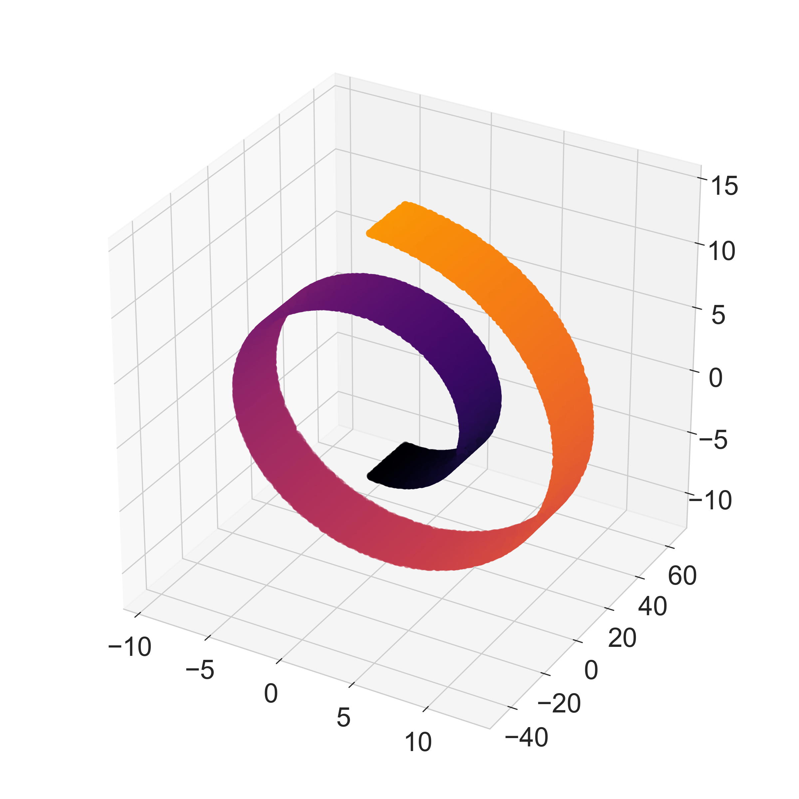
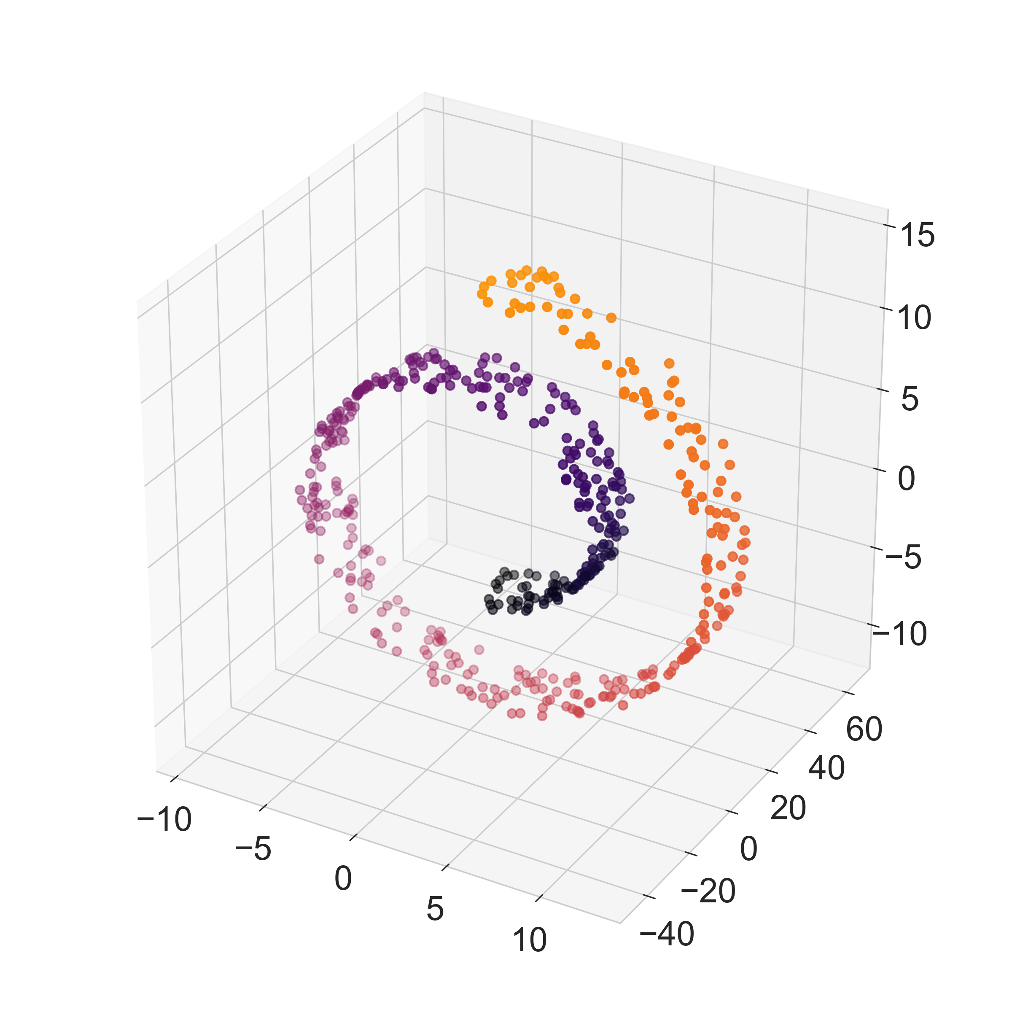
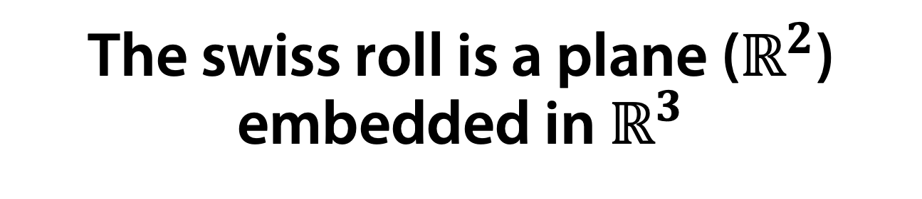
The swiss roll is a plane ($ℝ^{2}$) embedded in $ℝ^{3}$
True manifold
Data sampled from manifold

Slide 37
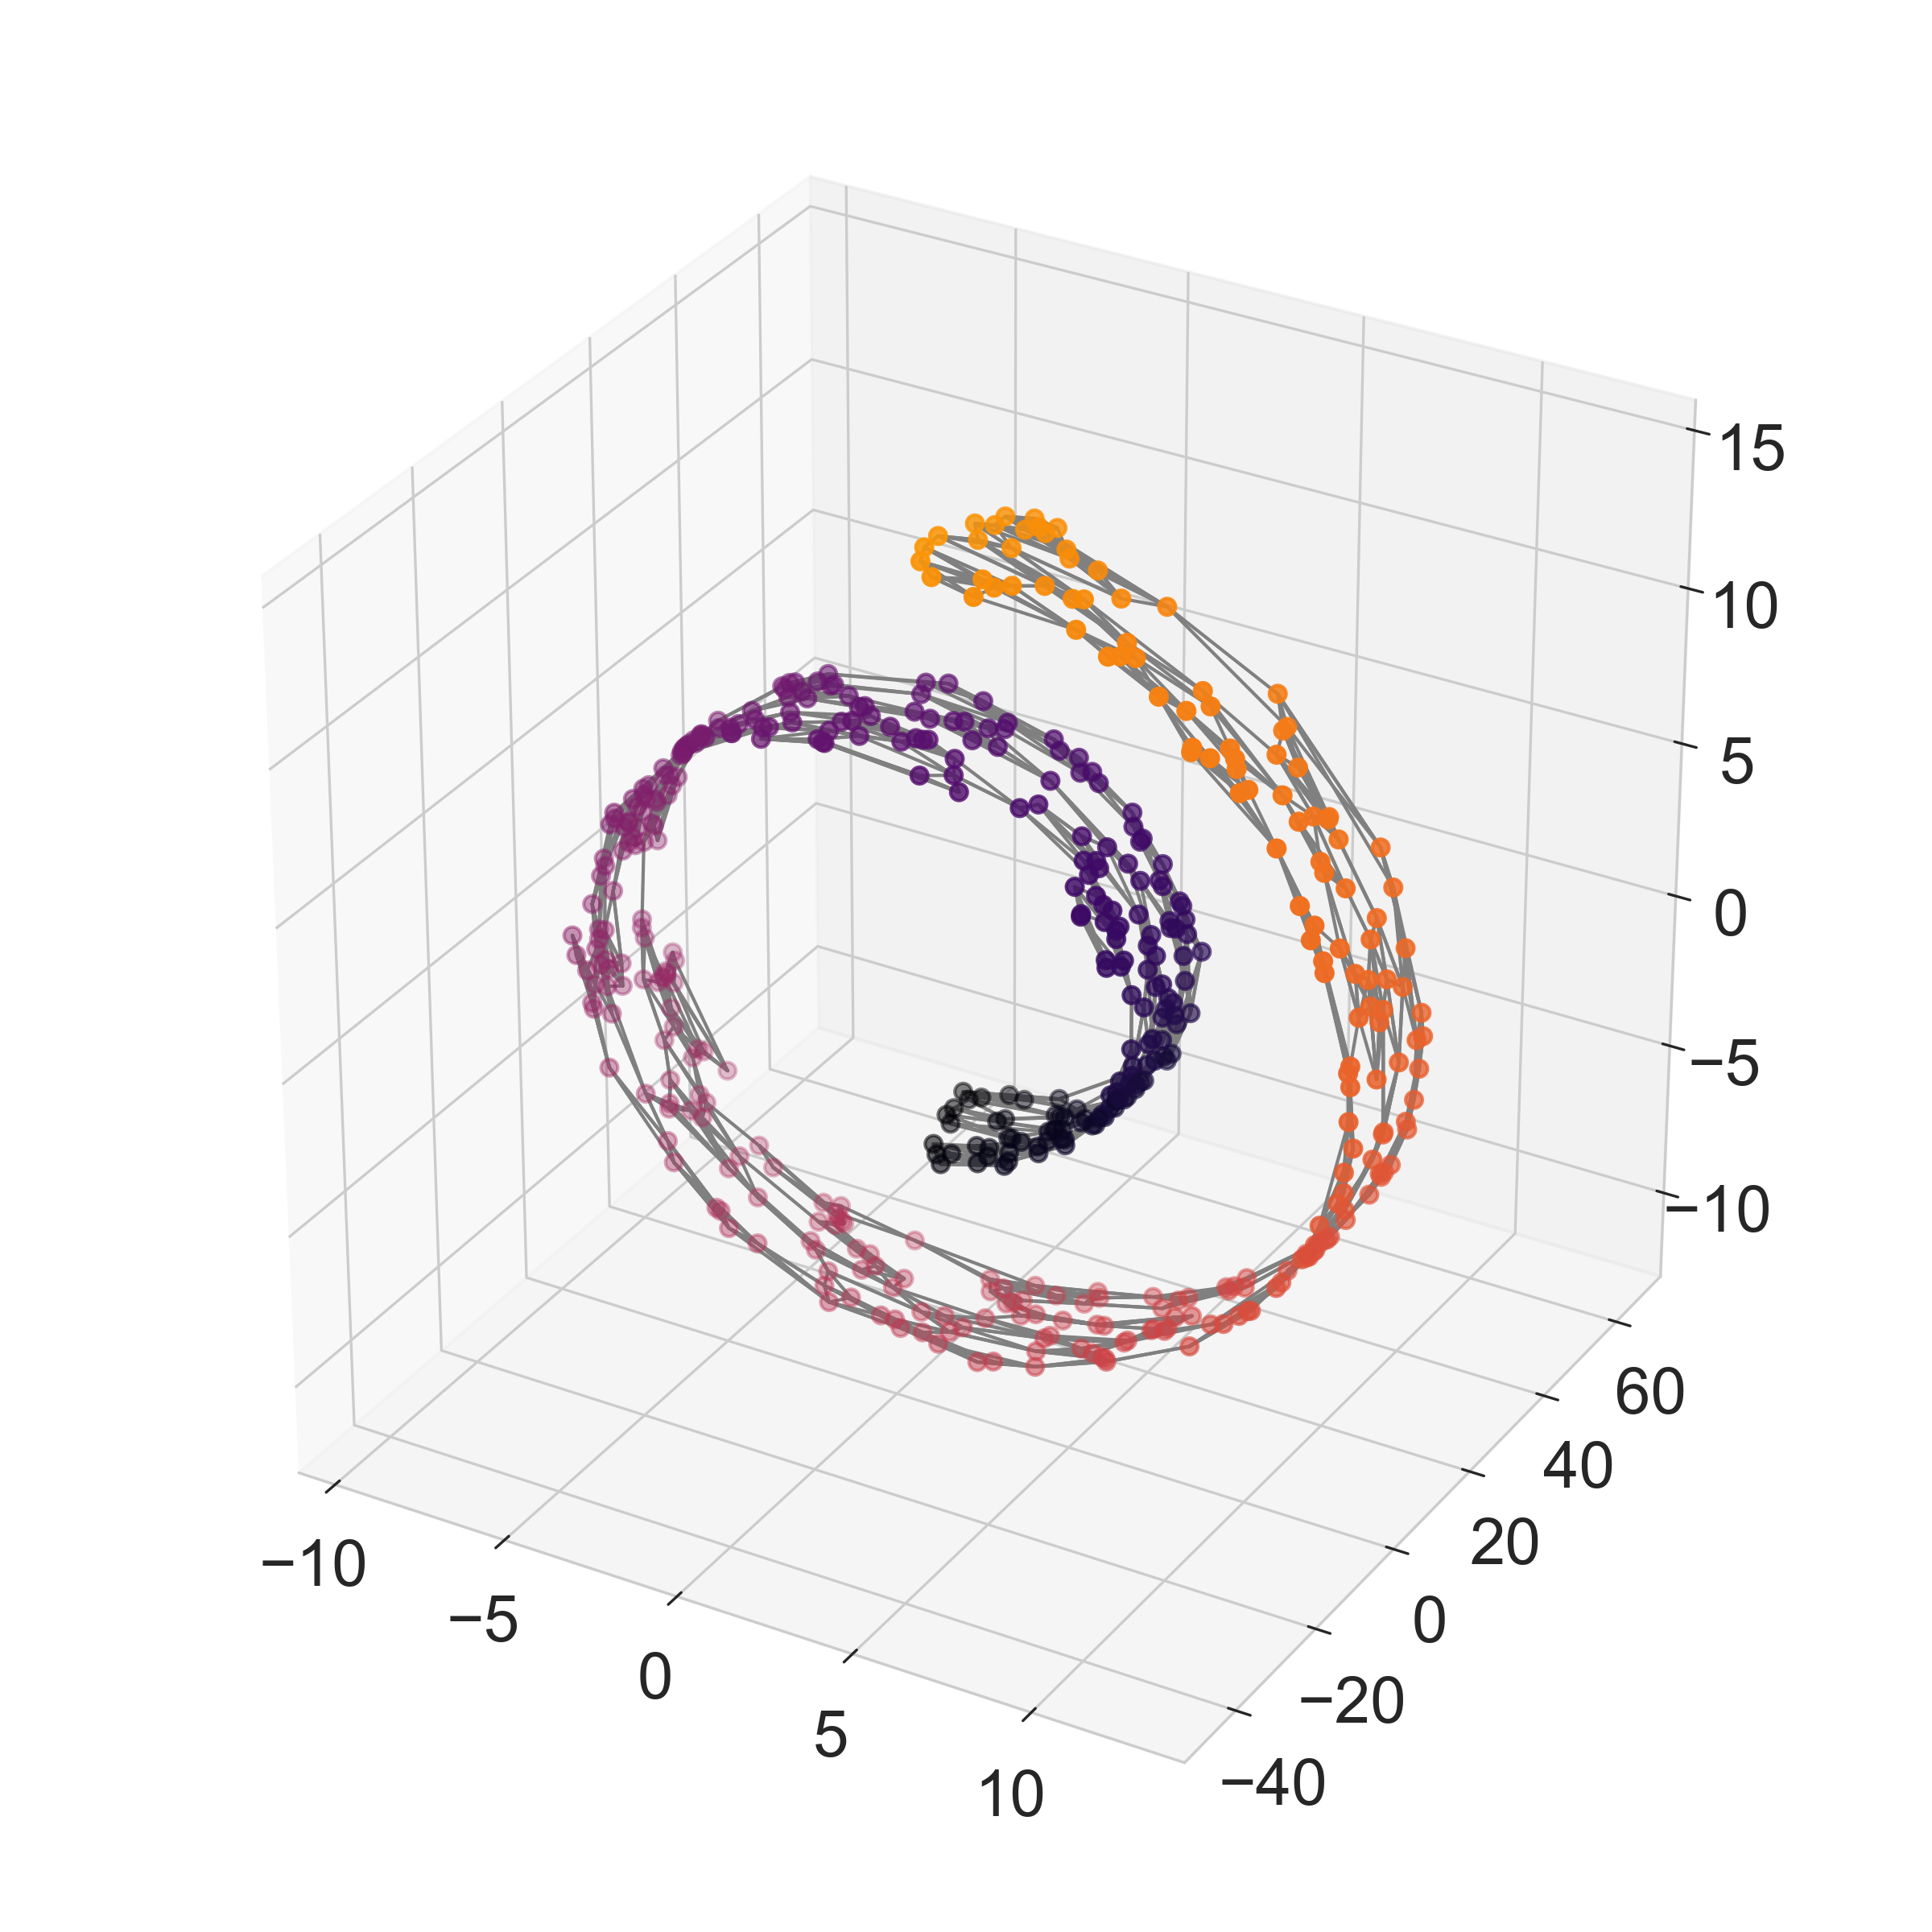
How do we find the data manifold?
If you connect the nearest neighbors of any data point with a line (also called EDGE) it forms a mesh of the data that can be unrolled to find the shape.
This is called a nearest neighbors graph
Edge

Slide 38
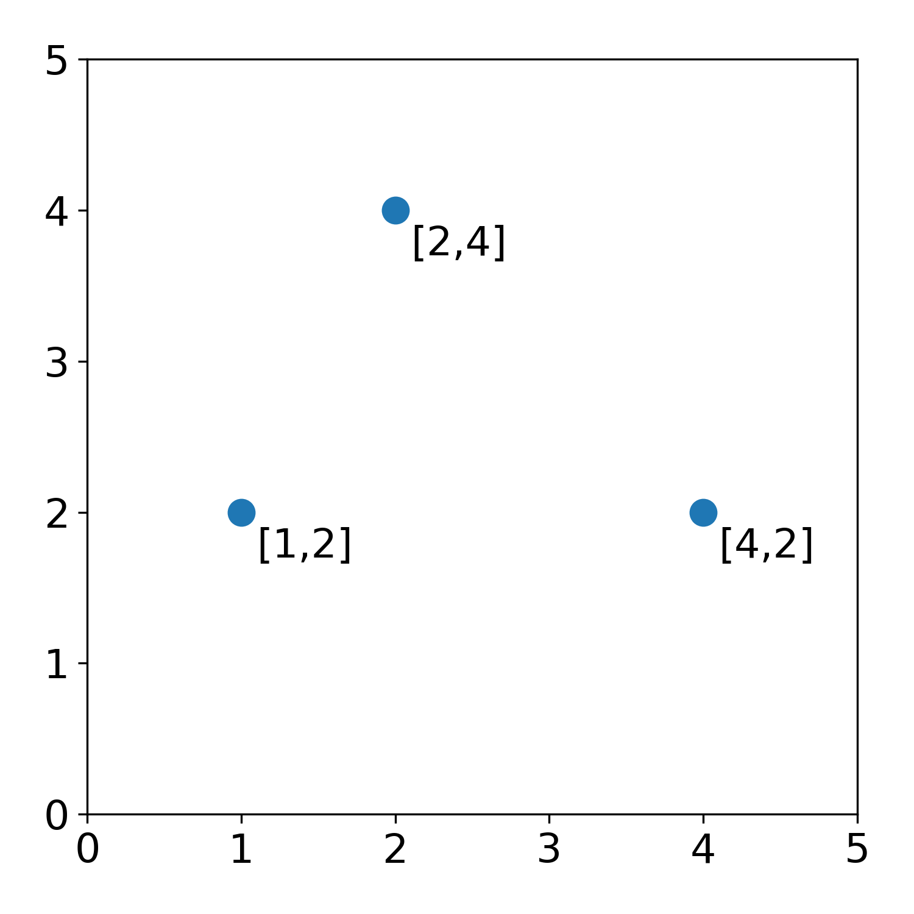
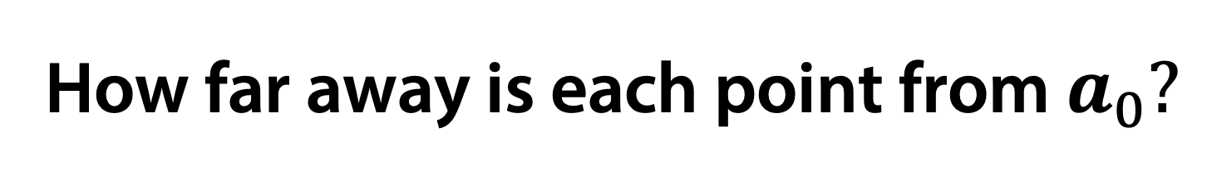
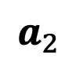
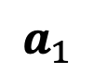
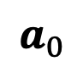
How far away is each point from $a_{0}?$
$$a_{1}$$
$$a_{0}$$
$$a_{2}$$

Slide 39
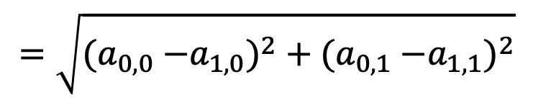
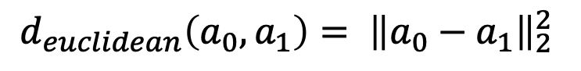
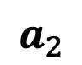
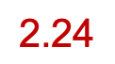




Euclidean Distance
$$a_{1}$$
$$d_{euclidean}\left(a_{0},a_{1}\right)= {\left\|a_{0}−a_{1}\right\|}_{2}^{2}$$
$$\text{2.24}$$
$$=\sqrt{{{(a}_{0,0} −a_{1,0})}^{2}+{{(a}_{0,1} −a_{1,1})}^{2}}$$
$$a_{0}$$
$$a_{2}$$
$$=\sqrt{{(1 −2)}^{2}+{(2 −4)}^{2}}$$
$$≈2\text{.24}$$

Slide 40




How far away is each point from $a_{0}?$
$$a_{1}$$
$$a_{0}$$
$$a_{2}$$

Slide 41


How far away is each point from $a_{0}?$
$$a_{1}$$
$$a_{0}$$
$$a_{2}$$

Slide 42







Manhattan Distance
Manhattan distance
$$a_{1}$$
$$d_{manhattan}\left(a_{0},a_{1}\right)=|a_{0,1} −a_{1,1}|$$
$$={|a}_{0,0} −a_{1,0}|+|a_{0,1} −a_{1,1}|$$
$$a_{0}$$
$$a_{2}$$
$$=|1 −2|+|2−4|$$
$$=3$$

Slide 43





How far away is each point from $a_{0}?$
$$a_{1}$$
$$a_{1}$$
$$a_{2}$$
$$a_{2}$$
$$a_{0}$$
$$a_{0}$$

Slide 44
Distances
There are many ways to measure distance
Hamming, Euclidean, Cosine
Distances are functions that take two points and return a real number that is positive or 0
Distances can be any function that is:
Symmetric: dist(a → b) = dist(b → a)
Non-negative: dist(a→b)>= 0
Follow triangle inequality: dist(a→c) <= dist(a→b) + dist(b→c)

Slide 45
Triangle Inequality

Slide 46






What is a “graph”?
Plot
Graph
$$a_{1}$$
$$a_{0}$$
$$a_{2}$$
$$G=(V,E)$$
$=V$ = vertices / nodes
$=E$ = edges

Slide 47




Example
Thing | Vertices | Edges
Internet | Computers | Network connections
Traffic | Intersections | Roads
Social network | People | Friendships
Cell similarities | Cells | Similarity relationships
$$G=(V,E)$$
$=V$ = vertices
$=E$ = edges
Notes:
Provide an example of real-world data that could be modeled as a graph. What would be the vertices and edges?
https://www.polleverywhere.com/discourses/Cci5kyNVuPw5asZqY2PrX

Slide 48


What is a “graph”?
Things that can be modelled as a graph
Graph
Thing | Vertices | Edges
Internet | Computers | Network connections
Traffic | Intersections | Roads
Social network | People | Friendships
Cell similarities | Cells | Similarity relationships
$$G=(V,E)$$
$=V$ = vertices
$=E$ = edges

Slide 49



How do we quantify close (local) versus far (global) in a dataset?
$$a_{1}$$
$$a_{0}$$
$$a_{2}$$
Notes:
Point out that A2 would be “sort of close” in Euclidean space

Slide 50
K Nearest Neighbors Graph
To turn data into a graph, connect the K closest neighbors of a graph
Measure closeness with your favorite distance

Slide 51
Affinity Matrix as Graph
Fully connected graph with edges weighted by an affinity (negatively proportional to distance)

Slide 52
Swiss Roll
$$a_{1}$$
$$a_{0}$$
$$a_{2}$$
Notes:
Point out that A2 would be “sort of close” in Euclidean space

Slide 53

Swiss Roll K-NN

Slide 54




Paths or “walks”on graphs reveal dominant data manifold directions
Shortest path between points
$$a_{1}$$
$$a_{0}$$
$$a_{1}$$
$$a_{2}$$
$$a_{2}$$

Slide 55

Notes:
What is the shortest path distance between a1 and a2?
https://www.polleverywhere.com/multiple_choice_polls/fUNNw8LzfYGwbCpJXxPBf

Slide 56


Graph walks approximate manifold distances
Shortest path between points
$$a_{1}$$
$$a_{0}$$
$$a_{1}$$
$$a_{2}$$
1
2
3
4
5
$$a_{2}$$
$d_{geodesic}\left(a_{1},a_{2}\right)=shortestpath(a_{1},a_{2}$)
$$=5$$

Slide 57

Graph walks approximate manifold distances

Slide 58
Graph walks approximate manifold distances

Slide 59


Exercise – choosing k
k = 5
k = 10

Slide 60

Kernel functions measure “similarity” or “affinity” on a graph

Slide 61



Affinity is the inverse of distance + locality
$$Affinity_{i,j}=s_{i,j}=exp\left(−\frac{dist{\left(x_{i}, x_{j}\right)}^{2}}{2σ^{2}}\right)$$

Slide 62

Distance to Affinity via Kernels
Real-valued
Non-negative
Symmetric
Affinities correlations in this hidden hypothetical space

Slide 63

Notes:
Which value of sigma produces the graph with the least global connectivity
https://www.polleverywhere.com/multiple_choice_polls/zTr7Kdvryx4DGwa6xKRK1

Slide 64


Effect of Changing Kernel Width
$$s_{i,j}=exp\left(−\frac{dist{\left(x_{i}, x_{j}\right)}^{2}}{2σ^{2}}\right)$$

Slide 65

Kernel PCA
data
distances
Affiniities
Use eigenvectors of an affinity matrix instead of covariance matrix
The family of methods called kernel PCA:
Specific variants include:
Laplacian Eigenmaps
Diffusion Maps

Slide 66

The graph Laplacian is a matrix representation of a graph
G
A adjacency matrix
D degree matrix
1
1
2
4
2
3
2
1
2
5
Laplacian matrix

Slide 67
Laplacian Eigenmaps
Eigenvectors of Laplacian matrix form Laplacian
Eigenmaps

Slide 68

Diffusion Maps
Data in high
dimensions
Eigendecomposition gives principal axes of manifold structure

Slide 69


Distance Matrix
Entries are distances
$$D\left(x_{i},x_{j}\right)=\sqrt{||x_{i}−x_{j}}||$$

Slide 70


Affinity Matrix
(Gaussian Kernel)
Graph Representation
Entries are affinities
$A\left(x_{i},x_{j}\right)=exp⁡(− \frac{{D(x_{i},x_{j})}^{2}}{σ}$)

Slide 71


Powered Markov Matrix
Powered Markov Matrix
Entries are row normalized affinities
M$\left(x_{i},x_{j}\right)$=$\frac{A\left(x_{i},x_{j}\right) }{\sum_{j}{A\left(x_{i},x_{j}\right) }}$

Slide 72



What does Powering Do?
Smooths and infers connectivity through data

Slide 73
2D Dimensionality Reductions
These methods preserve information from an affinity matrix in 2-3 dimensions exactly
There are as many eigenvectors as datapoints, so taking only the top 2 misses information
tSNE/UMAP: greedy method for preserving near neighbors in 2D
PHATE: creates a new distance matrix from a distance between diffusion probabilities of points and squeezes that variation into 2D

Slide 74


tSNE (and UMAP)
Goal: Maintain the local neighborhood of each cell
Steps: 1. Place points randomly in a 2D plane
2. Move points to locally optimal location via gradient descent

Slide 75

PHATE:
Goal: to preserve manifold structure
Step 1. Each cell is represented as a t-step diffusion probability to other cells
Step 2: Re-represent each point by its diffusion probabilities to all other points
C₁ = [ p₁₁ p₁₂ …….p_{1n}]
C₂ = [ p₂₁ p₂₂ …….p_{2n}]
…
C_{n} = [ p_{n1} p_{n2} …….p_{nn}]

Slide 76


Step 3. Define a new distance between points with this new representation
Step 4: Embed with multidimensional scaling
This reorganizes information in a diffusion map into 2D
C₁ = [ p₁₁ p₁₂ …….p_{1n}]
……
C_{i} = [ p_{i1} p_{i2} …….p_{in}]
…
C_{j} = [ p_{j1} p_{j2} …….p_{jn}]
…
C_{n} = [ p_{n1} p_{n2} …….p_{nn}]

Slide 77

Comparing visualization algorithms on single-cell data

Slide 78
Conclusions
Dimensionality reduction and visualization helps to identify structure in data
PCA uses eigenvectors to identify linear combinations of features that explain maximum variance
Manifold learning identifies non-linear patterns and structure
Graphs can be used to approximate manifolds and are helpful for modelling single cell data
Laplacian Eigenmaps and diffusion maps visualize data using dominant non-linear directions in data manifold
PHATE summarizes manifold information in 2D
UMAP, tSNE are non-linear methods focused on preserving local neighborhoods in 2D

Slide 79

Notes:
What questions do you have about today's lecture material?
https://www.polleverywhere.com/discourses/LcQaImIZ1dSuKR2Ww4pqu

